Slide 1
CS2033a/b Lecture 2 Image Manipulation “The Cool Stuff” Vivi Tryphonopoulos Section 002

Slide 2
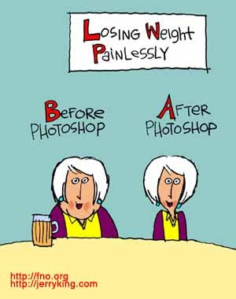
Topic Overview
Images
Resizing vs Resampling
Selection Tools revisited
Clip Mask from Text
How to draw a Path: how to draw and edit it
Creating a Type Path: Distributing Text to follow a Path or a Shape
Photo Correction Techniques
Clone Stamp
Spot Healing Brush
Content Aware Patch tool
Watch this clip!
http://www.youtube.com/watch?v=csHGXRbuM8M

Slide 3
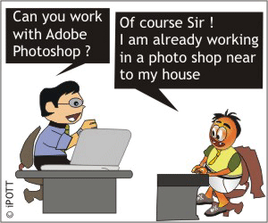

Slide 4
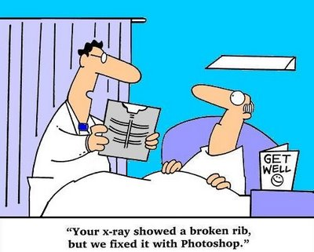
MORE WITH IMAGES
In CS1033: Photoshop Basic Fundamentals
Learned Photoshop with selection tools, Moving, Special effects Filter Galleries etc.
In CS2033: Photoshop
Next: “Cool Stuff”
Resizing vs Resampling
Fixing Flaws, removing things
Cloning, Patching
Puppet Warp.. And more
Masks, Channels

Slide 5
Topic Overview
“Photoshopped” now part of the dictionary
Image is digitally manipulated
An image that has literally been drawn or edited or touched up digitally manipulated
Watch this clip!
http://www.youtube.com/watch?v=csHGXRbuM8M

Slide 6
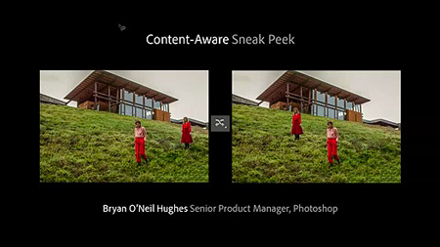
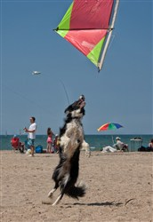
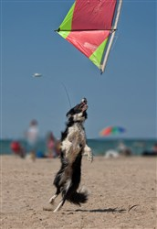
IMAGES: Newer features in CS6
Photoshop CS6
New modern user interface
Content-Aware Move /Patch/Extend tools
Blur Gallery
New Camera Raw 7
Redesigned vector and 3D engines
Newer Cropping features
Labs
Lectures
See feature comparisions

Slide 7
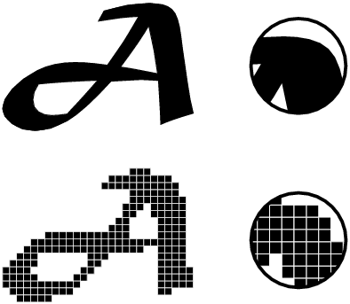
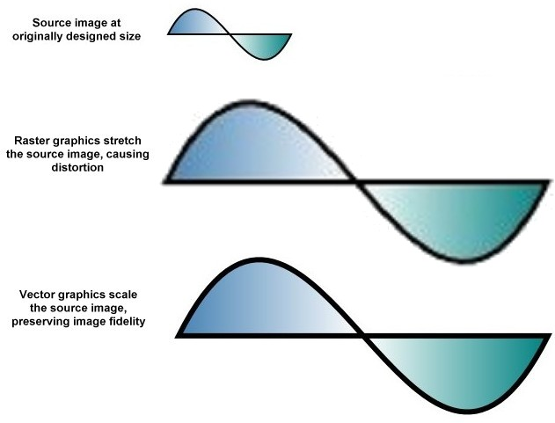
IMAGES: Photoshop Basic Fundamentals
Recap:
All photo images (from camera, scanner) are bitmapped images (.jpg .gif .png)
Bitmapped images: (Raster images)
smallest unit of an image is the pixel (square)
Blocky when increase in size
Vector images:
Are scalable -will not be blocky if you increase or decrease size
Resolution independent – takes on resolution of output device

Slide 8
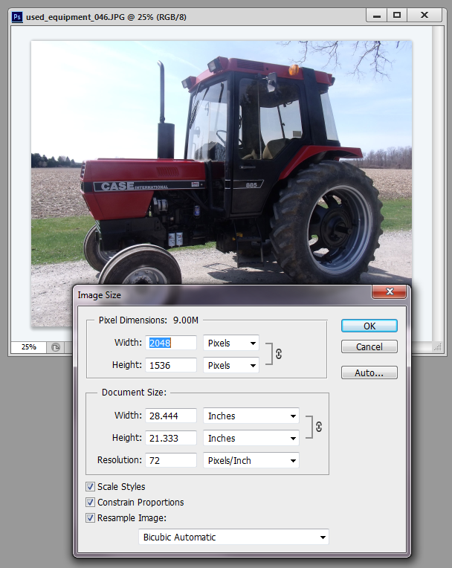
Resizing or Resampling
Is it the same?
What am I really adjusting?

Slide 9
IMAGES: Resizing Images vs. Resampling
To Change Image Dimensions:
Select Image> Size
Provides two measurements:
Pixel Dimensions
Document size
Would you like to
change the image dimensions for the web or for printing purposes
What is the correct term? Resize or Resample
Notes:
http://www.photoshopessentials.com/essentials/resizing-vs-resampling/

Slide 10
IMAGES: Resizing Images vs. Resampling
Resampling: (for web)
You are physically changing the pixel dimensions of the image for the web
Pixel Dimensions: = web
width/height of our image in pixels
For example: Width = 2048 Height=1536
Total # of pixels:
= 2048 x 1536 = 3,145,728
To change: simply type new values
Remember when going from smaller → larger dimensions you will get blurriness/pixelation
Notes:
http://www.photoshopessentials.com/essentials/resizing-vs-resampling/

Slide 11
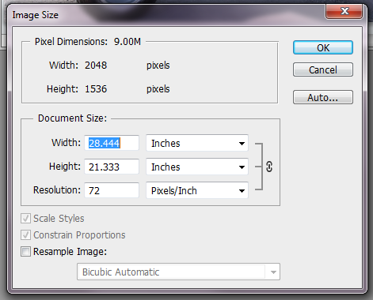
IMAGES: Resizing Images vs. Resampling
Resizing: (for printing)
You are changing how this image will be printed...
You are not adjusting the # of pixels in the actual file - pixel dimension stays the same - file size KB stays the same
Document Size: = printer
width/height of our image in pixels
For example when printed, it will be:
Width=28.444 inches Height =21.33
Resolution plays a big part in printing !! In this case it is 72ppi
Notes:
http://www.photoshopessentials.com/essentials/resizing-vs-resampling/

Slide 12
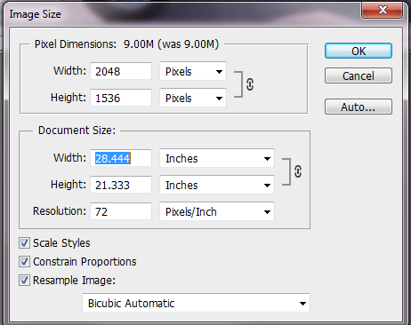
IMAGES: Resizing Images
Resizing Images: (PRINTER)
You must uncheck Resample box
keeps the number of pixels in your image Resample box
by restricting you from changing the size (grayed out) So pixel dimension does not change
Affects how large your image will print based on the resolution value
Adjust the resolution value to get the right size printed
When you uncheck
Notes:
http://www.photoshopessentials.com/essentials/resizing-vs-resampling/

Slide 13
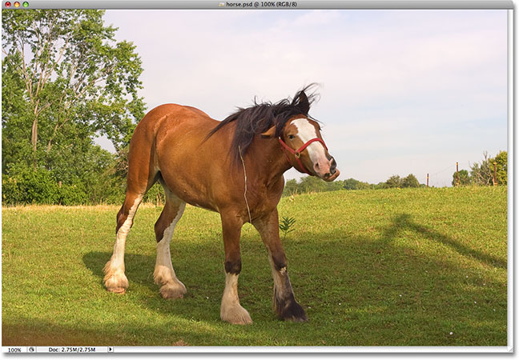
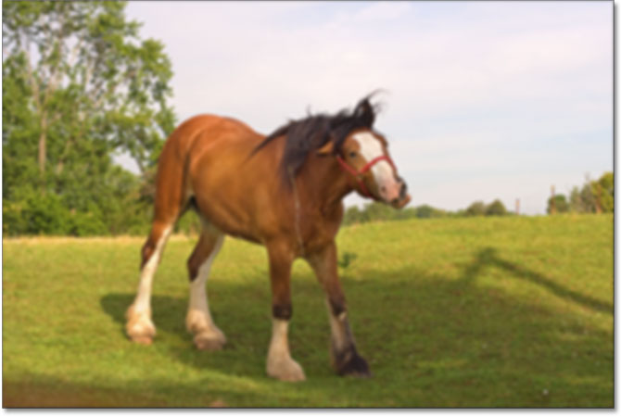

IMAGES: Resizing Images
Resizing Images: (Printer)
Image Resolution and Print Quality
So you work with changing the Resolution value
It leaves the original pixel dimensions _________
Original on web
1200 x 800px
Printed at 72 ppi
1200/72 = 16.6”
800/72= 11”
Prints 16.6” x 11”
Printed at 600 ppi
1200/600 = 2” 800/600=1.3”
Prints at 2” x 1.3”
Notes:
http://www.photoshopessentials.com/essentials/resizing-vs-resampling/

Slide 14
IMAGES: Resizing Images
Resizing Images: (Printer)
Let’s look at how original size and resolution affects the printed copy of the image
Trend:
For any given image a lower resolution (7 ppi) will print bigger than a higher resolution (300 or 600 ppi)
Camera (megapixels) | Image Size | 72ppi | 300ppi | 600ppi
1 | 1200 x 800 | 16.6 “ x 11” | 4 x 2.6 | 2 x 1.3
2 | 1600 x 1200 | 22” x 16.6 | 5.3 x 4 | 2.6 x 2
3 | 2048 x 1536 | 28.4 x 21.3 | 6.8 x 5.2 | 3.4 x 2.6
6 | 3032 x 2008 | 42.1 x 27.9 | 10.1 x 6.7 | 5.1 x 3.3
8 | 3264 x 4448 | 45.3 x 61.7 | 10.9 x 14.8 | 5.4 x 7.4
11 | 4064 x 2704 | 56.6 x 37.5 | 13.54 x 9.1 | 6.7 x 4.5
36 | 7200 x 4800 | 100” x 66.6” | 24 x 16” | 12 x 8
http://www.bhphotovideo.com/FrameWork/charts/resolutionChartPopup.html
Notes:
http://www.photoshopessentials.com/essentials/resizing-vs-resampling/

Slide 15
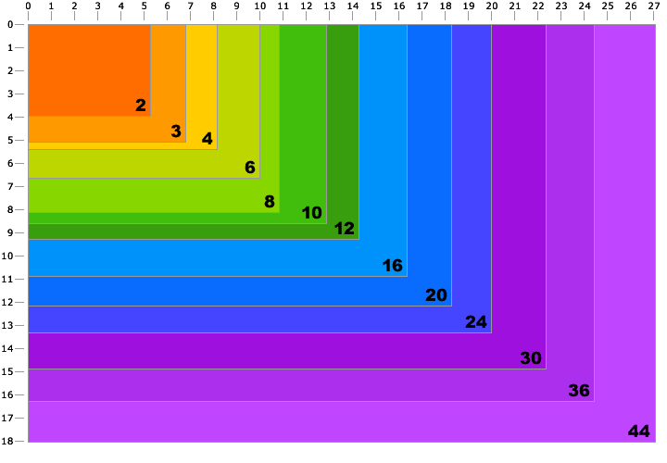
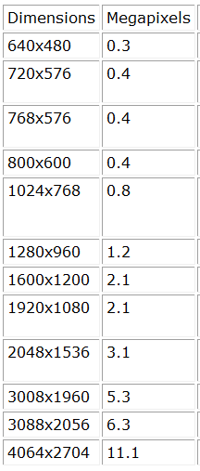
Each colored box represents a certain number of megapixels. The numbers along the top and left side are print dimensions in inches at 300ppi Most books and magazines require 300ppi for photo quality. For example, the chart shows that you can make a 5" x 7" photo quality print from a 3 megapixel camera.
http://www.design215.com/toolbox/megapixels.php

Slide 16
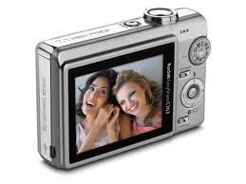
IMAGES: Resizing Images
Resizing Images: (Printer)
QUESTION: What if you want a print size of 16.6 x 11 AND clear in quality?
SOLUTION:
http://www.bhphotovideo.com/FrameWork/charts/resolutionChartPopup.html
Notes:
http://www.photoshopessentials.com/essentials/resizing-vs-resampling/

Slide 17
Now Let’s look at
Resampling
What am I really adjusting?

Slide 18
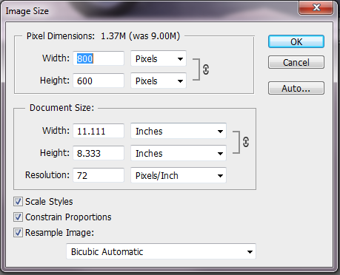
IMAGES: Resampling Images
Resampling Images: (Web )
Must check off
Resample
Affecting the physical dimensions of the image
You are changing the Pixel Dimensions
Selecting Image> Size
Change width/height of our image in pixels 2048 x 1536 → 800 x 600
Notice document size changes as well
Notes:
http://www.photoshopessentials.com/essentials/resizing-vs-resampling/

Slide 19
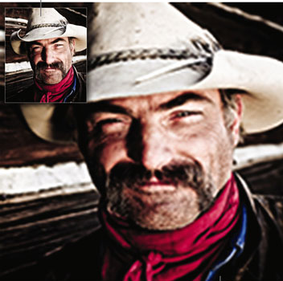
IMAGES: Resampling Images
So what does Resampling Mean?
Physically changes the number of pixels in your image
Downsampling: Scaling it down: Eliminating pixels and therefore deleting information and detail from your image Technique called “decimation”
Upsampling: Scaling it up: Adding pixels through a technique called “interpolation”

Slide 20
IMAGES: Resampling Images
How does Decimation and Interpolation work?
Downscaling
How does decimation work?
Eliminates by averaging the values of source pixels contributing to each output pixel.
Casts off unnecessary information by averaging together pairs of pixels or groups of pixels.
Result in faithful tonality.
Upscaling
How does Interpolation work?
Photoshop analyzes the colors of the original pixels and “manufactures” new pixels which are then added to the existing ones
Guesses the values of the unknown pixels

Slide 21
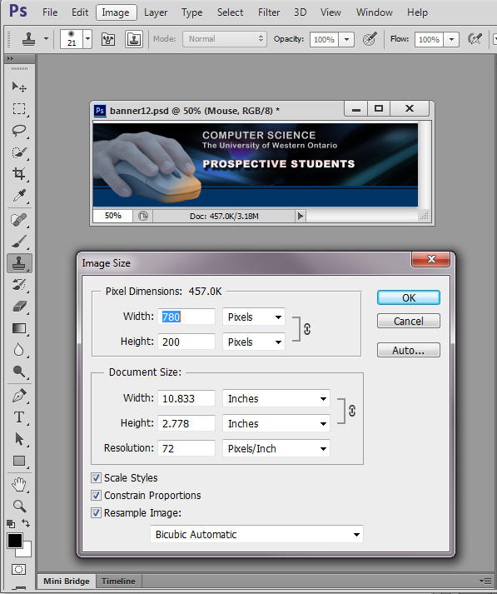
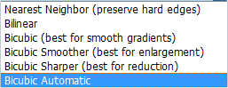
IMAGES: Resampling Images
Decimation and Interpolation is controlled through the Box at the bottom:
It gives you 6 Interpolation options that identify the algorithm used to either add pixels or eliminate pixels :
Note: Decimation is using the Bicubic Sharper option

Slide 22
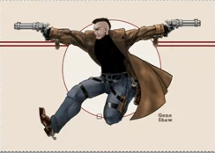
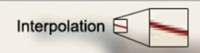
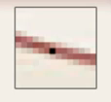
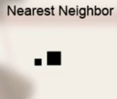
http://www.youtube.com/watch?v=5CSP7VZqVjg
IMAGES: Resampling
6 Interpolation Methods: How do you want Photoshop to translate your pixels when you resize it (larger or smaller)
Basically they analyze the color of the pixels
Use that information to determine the new color values of the new pixels.
Nearest Neighbor:
Most basic/least sophisticated but fastest method
Takes pixel color and assigns it to the new pixels that are created (uses the same color)
Poor poor quality, jagginess

Slide 23
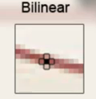
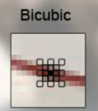
IMAGES: Resampling
Interpolation Methods:
Bilinear:
Averages the color of the 4 pixels around it and performs simple linear calculations
Less jagginess but still not good quality
Bicubic: (default)
Averages the color of the 16 pixels so larger sample size to draw from
Most sophisticated algorithm to give great results - Most commonly used
Best for smooth gradients

Slide 24
IMAGES: Resampling with Interpolation
Next 3 are part of the Bicubic method
Bicubic Smoother:
Great for upsampling
Averages from even more than 16 pixels
Adds a blurriness pass but great photos
Bicubic Sharper:
Good method for downsampling image
Decimation technique: Eliminates by averaging the values of source pixels contributing to each output pixel.
Makes file smaller and retains edge details by doing a sharpening pass
Bicubic Automatic: (default)
Detects if upsampling (Bicubic Smoother)
Detects if downsampling (Bicubic Sharper)

Slide 25
IMAGES: Summary Resizing vs Resampling
Resizing ( for Printing purposes)
You are NOT adjusting the # of pixels in the actual file You are changing how the image will be printed on paper (dimensions)
Resolution plays a major part in how big image will be when printed
To print a “photo quality” 8.5 x 13” Need at least 300 ppi resolution and a camera with atleast 10 megapixels
Resampling (for web purposes)
Physically changes the number of pixels in your image
You are downsampling or upsampling
Based on interpolation techniques (or decimation)

Slide 26
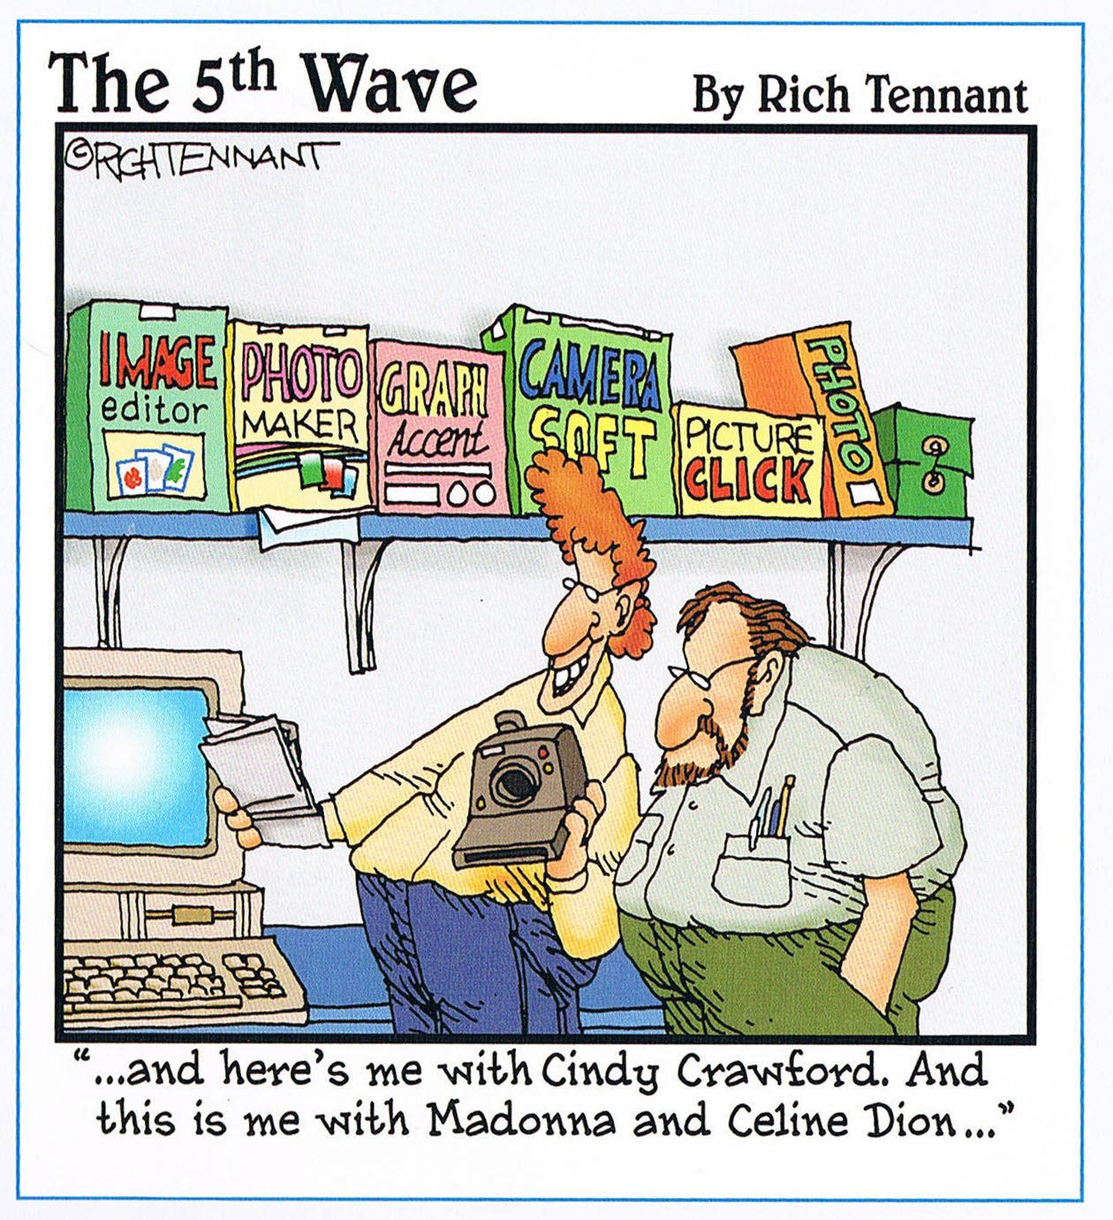
IMAGES: Photoshop Tools
The difference between great Photoshop users
and the “Wannabees”
Knowing how
to make those selections so it looks like it belongs

Slide 27
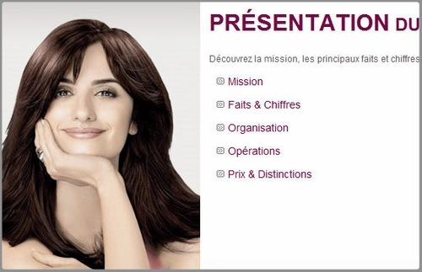
IMAGES: Photoshop Tools
Photoshopped or Not?
Penelope Cruz
L’Oreal Website
http://www.popcrunch.com/15-most-ridiculous-celebrity-photoshop-disasters/

Slide 28

IMAGES: Photoshop Tools
Photoshopped or Not?
Jessica Alba
Campari Wine
http://www.popcrunch.com/15-most-ridiculous-celebrity-photoshop-disasters/

Slide 29
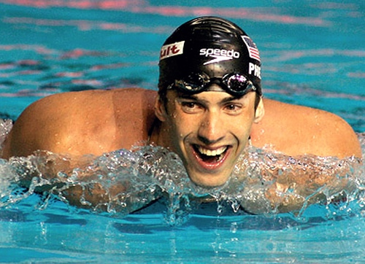
IMAGES: Photoshop Tools
Photoshopped or Not?
Michael Phelps
TV Guide

Slide 30

IMAGES: Photoshop Tools
Photoshopped or Not?
Demi Lovato
Walt Disney

Slide 31
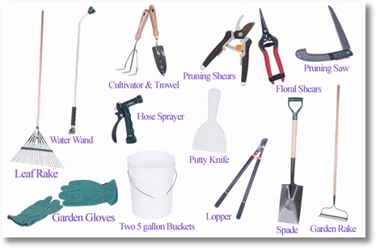

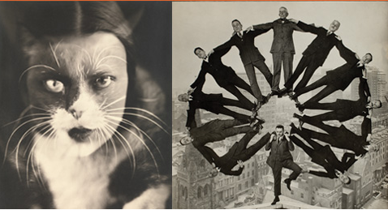
IMAGES: Selection Tools
Selecting in Photoshop
Each tool has its strengths and weaknesses
Recognizing what you need to select and deciding which is the best tool!
It will make your life easier and give you a professional look!

Slide 32
IMAGES: Selection Tools
Working with Image Areas:
Use different tools to select parts of an image
Marquees
Lasso
Quick Selection
Wand
Some are better suited than others!

Slide 33
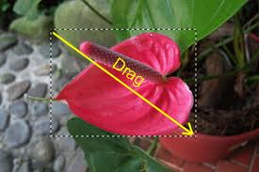

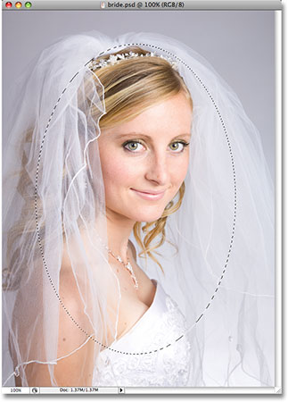
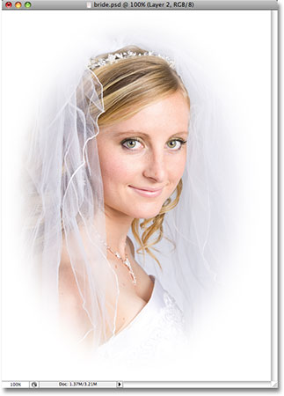
IMAGES: MARQUEE Selection tools
Rectangular Marquee
Select an area of the photo by drawing a rectangular marquee (Square, box, rectangle)
Move marquee into another picture
Elliptical Marquee
Select an area of the photo by drawing a circular or elliptic marquee (circle, ellipse, oval)
Move marquee into another picture

Slide 34
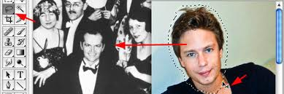
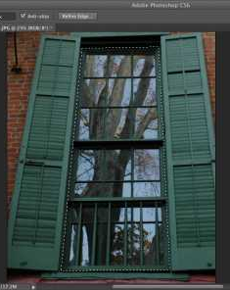

IMAGES: LASSO Selection tools
Lasso
Make free form segments of selection border
Polygonal Lasso
Make straight-edged segments of a section border
Best for selecting straight edged lines

Slide 35
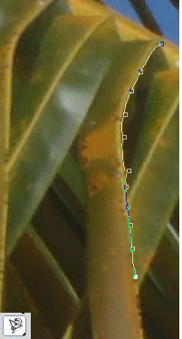

IMAGES: LASSO Selection tools
Magnetic Lasso:
Select portions of an image with complex edges that are set against high contrast background. “snapping effect”
Can accurately select areas that contain many colors.

Slide 36
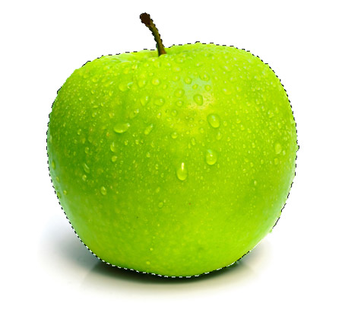
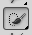
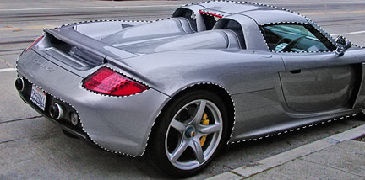
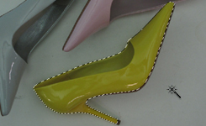
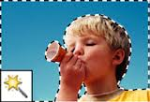
IMAGES: QUICK Selection tools
Quick Selection
Make accurate selection of complex shapes based on color and texture
Using an adjustable brush
Drag the brush, and area expands
Magic Wand
Used to select pixels of an image that are similar in color or brightness with a single click

Slide 37
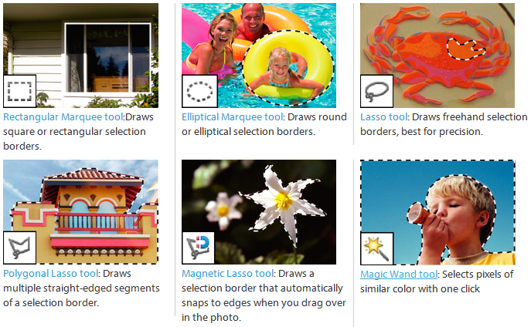
SELECTION TOOLS

Slide 38
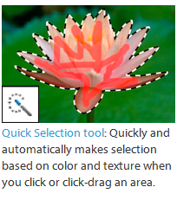
SELECTION TOOLS

Slide 39
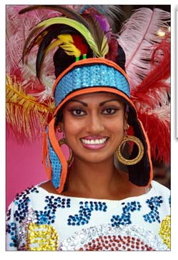
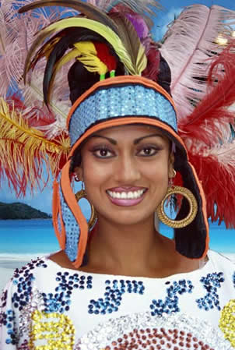
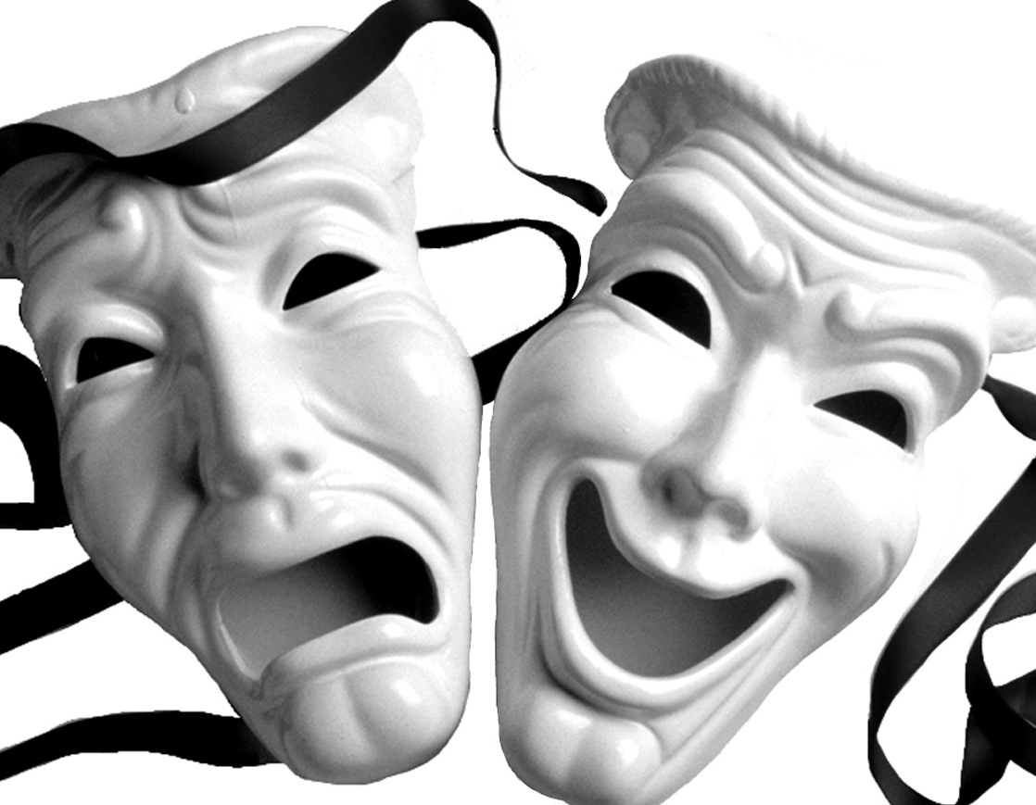
SELECTION TOOLS
So can those tools easily handle situations such as these?
Power of Using
Masks
Stay tuned for next lecture

Slide 40
WHAT ARE YOU LEARNING IN YOUR LAB NEXT WEEK:
Clip Mask from Text
How to draw a Path: how to draw and edit it
Creating a Type Path: Distributing Text to follow a Path or a Shape
Photo Correction Techniques
Clone Stamp
Spot Healing Brush
Content Aware Patch tool
Combining Images

Slide 41

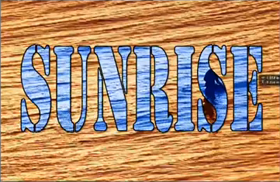

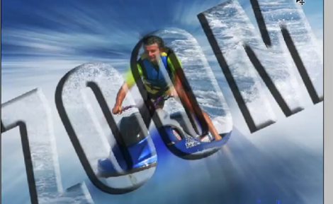

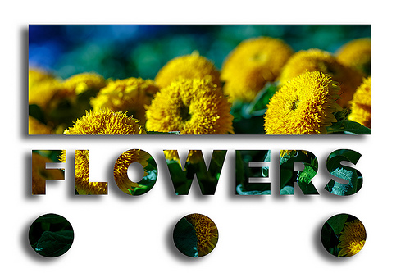
WHAT ARE YOU LEARNING IN YOUR LAB NEXT WEEK:
Clipping Mask
Allows you to texturize the look using another photo
The clipping mask can be Letters or Shapes

Slide 42




http://www.youtube.com/watch?v=lA6mulK9A6g
WHAT ARE YOU LEARNING IN YOUR LAB NEXT WEEK:
Clipping Mask
A clipping mask is an object or group of objects whose shape masks other artwork so that only areas that lie within the clipping mask are visible.
Put a Background on these masks and the artwork conforms to the shape of the mask
You are clipping the artwork to conform to the shape of the object (or mask). **IT MUST BE ABOVE THE MASK
The Clip is denoted by that
Artwork
Mask
http://www.pxleyes.com/video-tutorial/photoshop-elements/6374/Combine-Photos-and-Text.html

Slide 43



http://www.youtube.com/watch?v=lA6mulK9A6g
WHAT ARE YOU LEARNING IN YOUR LAB NEXT WEEK:
Paths
Creating paths with the Pen tool
Most underutilized tool
Create:
Straight paths
Curved paths
Shapes (triangles, circles, rectangles etc) - CLOSED PATHS
They are vector based not bitmapped
http://www.pxleyes.com/video-tutorial/photoshop-elements/6374/Combine-Photos-and-Text.html

Slide 44







http://www.youtube.com/watch?v=lA6mulK9A6g
WHAT ARE YOU LEARNING IN YOUR LAB NEXT WEEK:
Paths
Benefits of a path
To add text to follow the path
Add text inside of a closed shape
Add text to follow a shape
Use a path to make a selection instead of using selection tools
http://www.pxleyes.com/video-tutorial/photoshop-elements/6374/Combine-Photos-and-Text.html

Slide 45


WHAT ARE YOU LEARNING IN YOUR LAB NEXT WEEK:
Paths
A line with anchor points at either end. It can be a straight line or it can be curved, depending on how you create it.
Parts of a Path:
Anchor points mark the end points of the path segment
Each anchor has 1 or 2 direction lines ending in direction points
A – Curved line segment
B - Direction point
C - Direction Line
D - Selected anchor point
E - Unselected anchor point
http://www.infiniteskills.com/training/learning-adobe-photoshop-cs6.html

Slide 46
WHAT ARE YOU LEARNING IN YOUR LAB NEXT WEEK:
Photo Correction Techniques
Clone Stamp
Spot Healing Brush
Content Aware Patch tool
http://www.infiniteskills.com/training/learning-adobe-photoshop-cs6.html

Slide 47



WHAT ARE YOU LEARNING IN YOUR LAB NEXT WEEK:
Clone Stamp
Fills in missing areas in photos
Removes unwanted objects
Clone a pattern onto a selection
How does it do it? Uses pixels from one area of an image to replace the pixels in another part of the image
You must specify the spot to clone (sample spot, point of reference)
http://www.infiniteskills.com/training/learning-adobe-photoshop-cs6.html

Slide 48


WHAT ARE YOU LEARNING IN YOUR LAB NEXT WEEK:
Spot Healing Brush
Removes “small” unwanted objects
Ie. Blemishes, acne, bird in the sky
How does it do it?
It does not require a sample spot (Clone tool)
It paints with sampled pixels around the spot you are removing
Fixes with a round brush
It matches the texture, lighting, transparency and shading of the sampled pixels to the pixels being healed
http://www.infiniteskills.com/training/learning-adobe-photoshop-cs6.html

Slide 49


WHAT ARE YOU LEARNING IN YOUR LAB NEXT WEEK:
Healing Brush
Removes unwanted objects
Ie. Tattoos, wrinkles, scratches
How does it do it?
It requires a sample spot ( like Clone tool)
Sample spot tells it which part of the image to use to repair with
Then mouse over to the bad spot to brush it away.
Tip: select sample spot near the problem spot.. So texture and color match better.
http://www.infiniteskills.com/training/learning-adobe-photoshop-cs6.html

Slide 50


WHAT ARE YOU LEARNING IN YOUR LAB NEXT WEEK:
Content Aware Tool
Move objects seamlessly into other spots in your photos
Path selections Create the selection and drag it slightly in the direction you want to extend it towards.
http://www.iceflowstudios.com/2012/tutorials/photoshop-cs6-beta-content-aware-move-tool/

Slide 51

WHAT ARE YOU LEARNING IN YOUR LAB NEXT WEEK:
Content Aware Tool
Extend a selection Create the selection and drag it slightly in the direction you want to extend it towards.

Slide 52
Next week
More Photoshopping!
Stay tuned with Masks, Filters , Blending mode, Filters and More!!
See you next week!
http://www.infiniteskills.com/training/learning-adobe-photoshop-cs6.html

